Slide 1
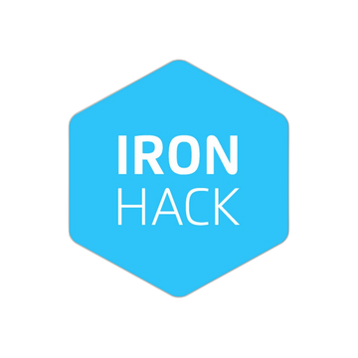
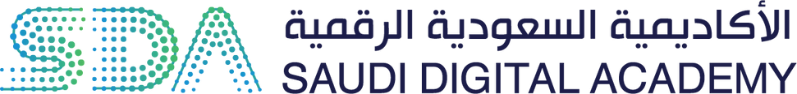
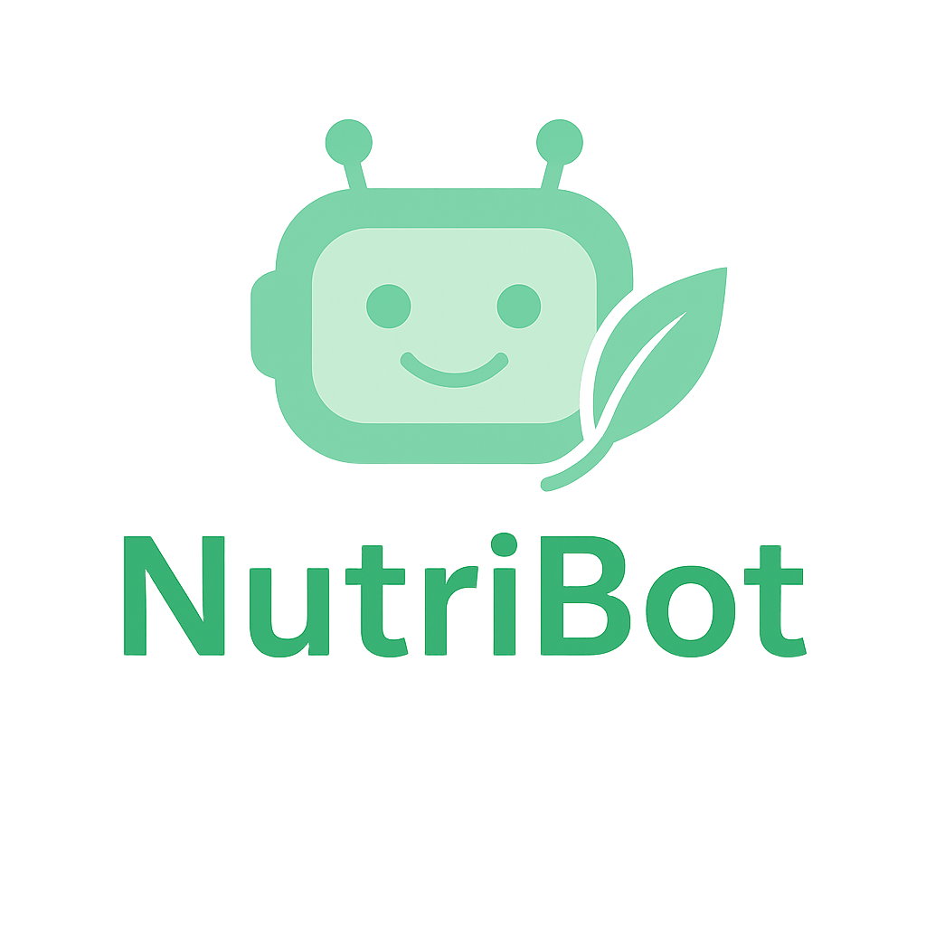
NUTRIBOT
Ghala Ali Al-Otaibi
Himmah AI Engineering Bootcamp

Slide 2
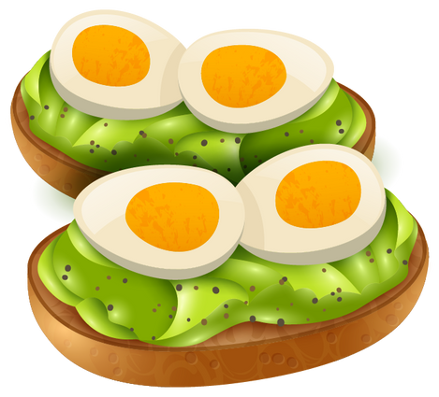
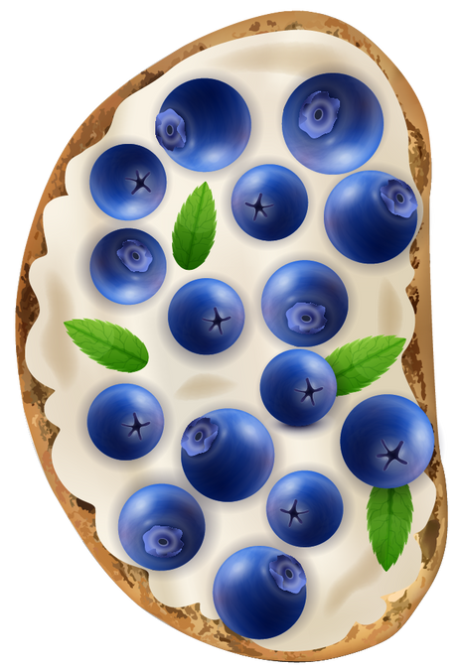
TABLE OF CONTENTS
01
02
INTRODUCTION
NUTRIBOT AND ITS USERS
Motivation why NutriBot?
What the system does and who it is built for?
03
04
SYSTEM ARCHITECTURE
DEMO AND USER INTERFACE
How NutriBot works behind the scenes?
Live walkthrough of the chatbot experience

Slide 3
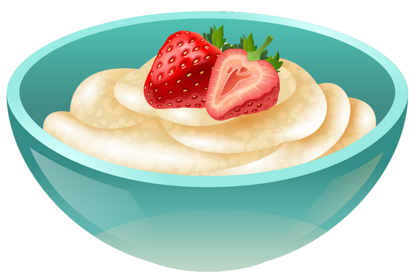
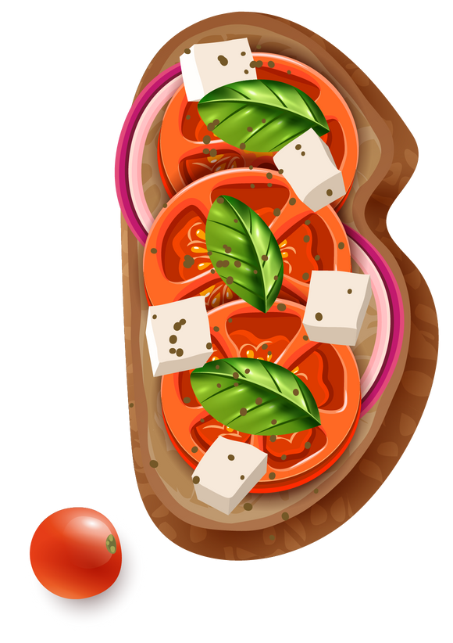
INTRODUCTION
Motivation – Why NutriBot?
Many patients with chronic conditions struggle to find the right nutritional guidance
NutriBot aims to make trusted guidance easier, faster, and more accessible
Proper nutrition plays a key role in managing health, yet many patients feel lost

Slide 4
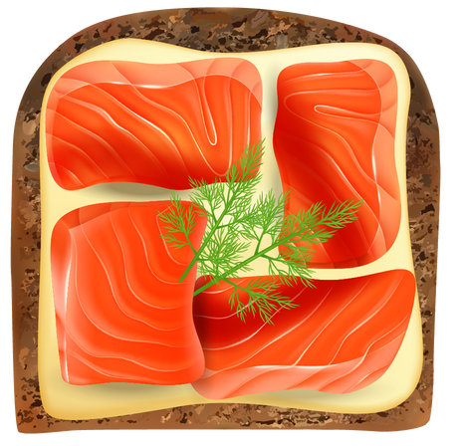
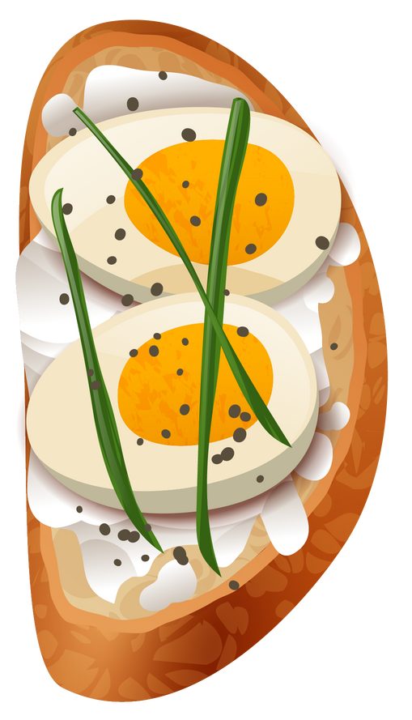
NUTRIBOT AND ITS USERS
What the system does and who it is built for?

Slide 5
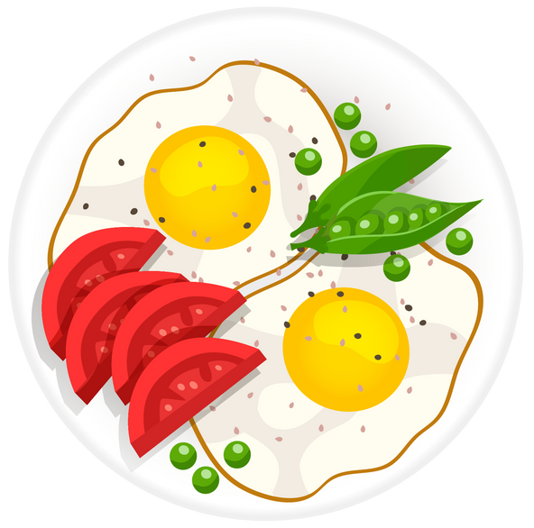
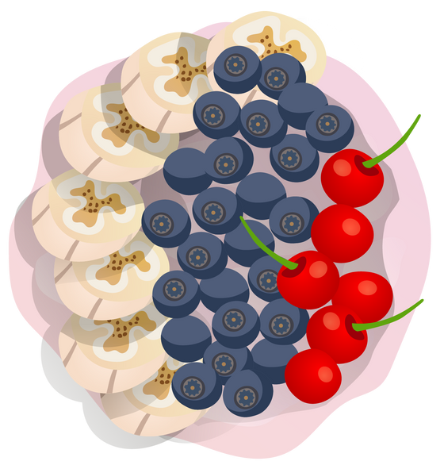
What is NutriBot?
AI-powered chatbot for personalized nutrition advice
Supports text, voice, and image input
Available in two languages English and Arabic

Slide 6
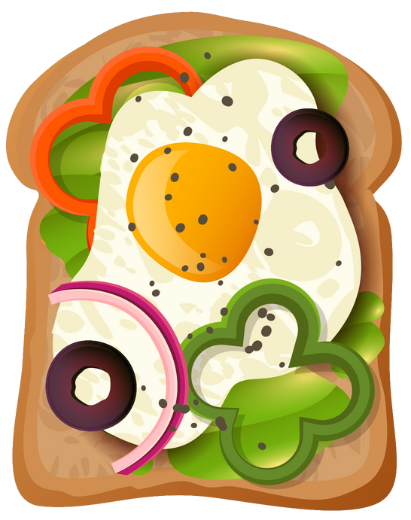
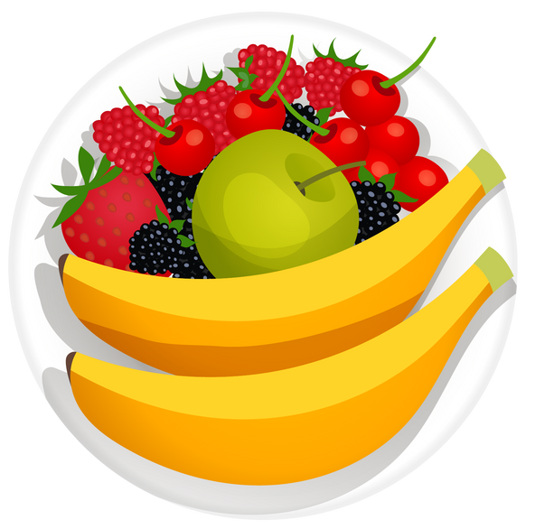
Why NutriBot is Unique?
Built using trusted clinical sources
Accepts multimodal input (text, voice, image)
Supports Arabic & English
Based on real health needs and real user data

Slide 7
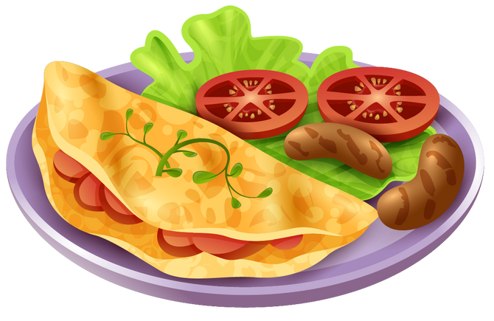
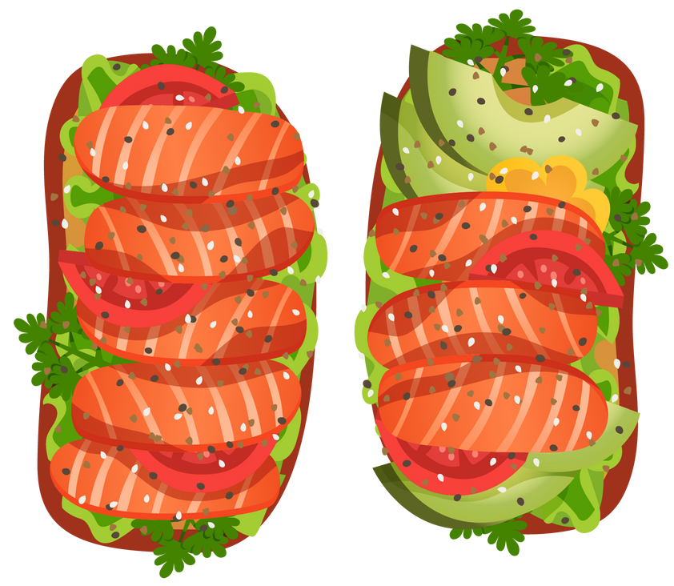
Who NutriBot Helps?
Health-conscious individuals
People with chronic conditions (anemia, diabetes, IBS, etc.)
Healthcare professionals supporting dietary needs

Slide 8
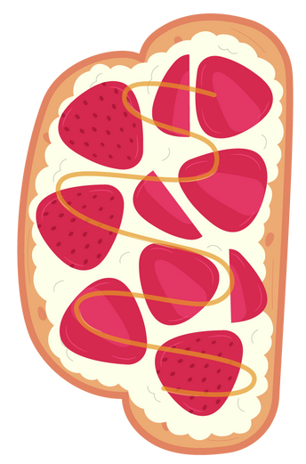
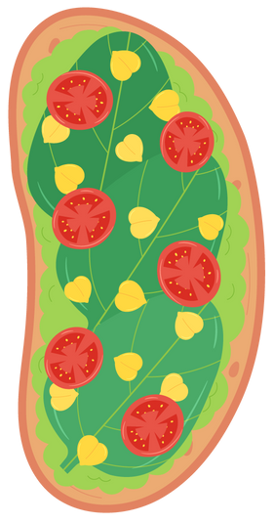
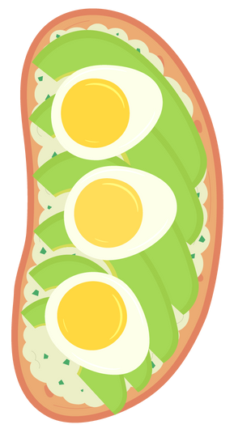
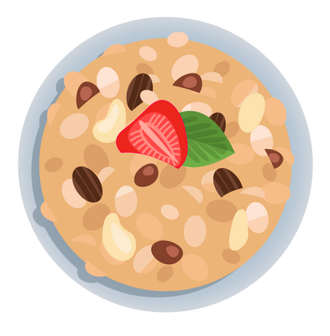
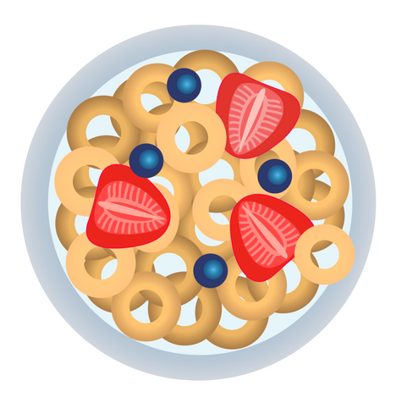
SYSTEM ARCHITECTURE
Let’s explore how NutriBot works behind the scenes...

Slide 9
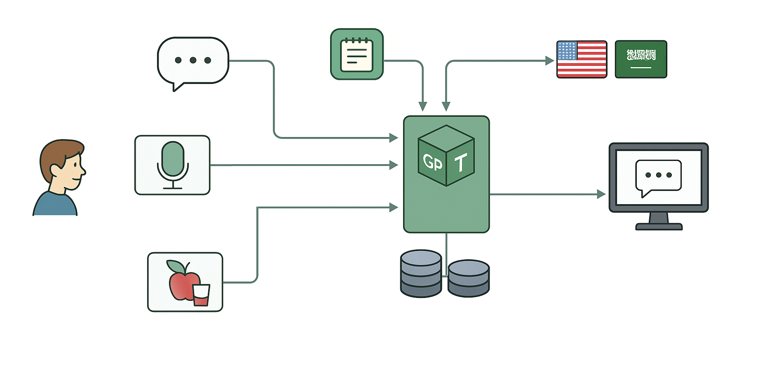
Remembers past questions
Translation based on user’s choice
Type a question
Smart system understands and responds
Speak a question
The user can choose how to interact
Shows the answer in a simple interface
Finds answers from trusted nutrition sources
Send a food image

Slide 10
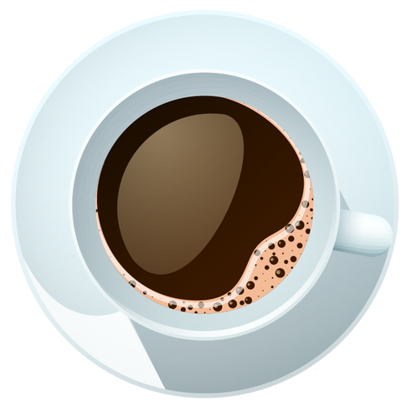
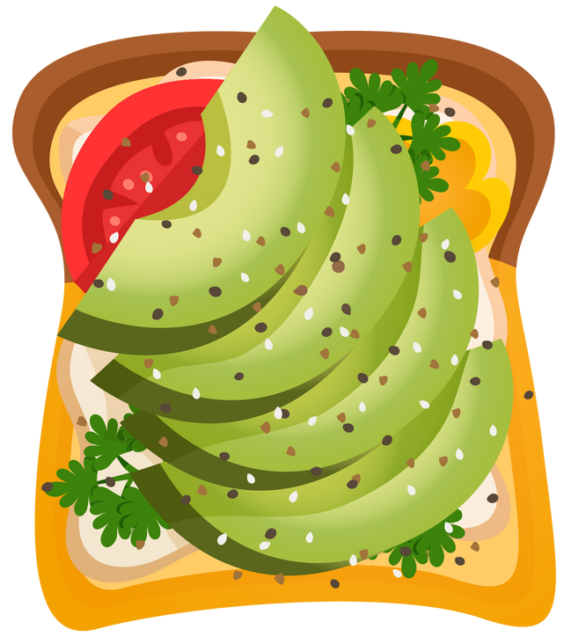
SYSTEM DEMO AND INTERFACE
Live walkthrough of the user interface

Slide 11
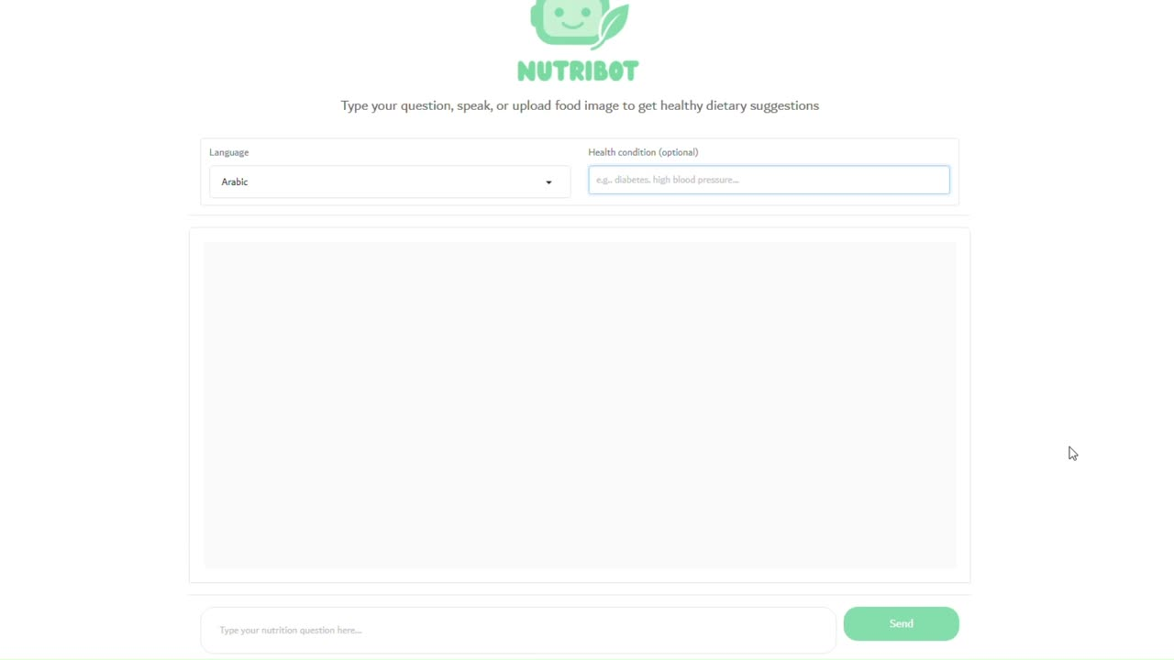

Slide 12
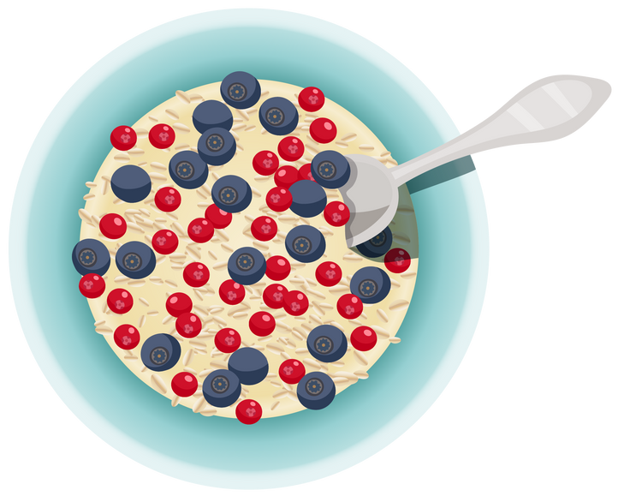
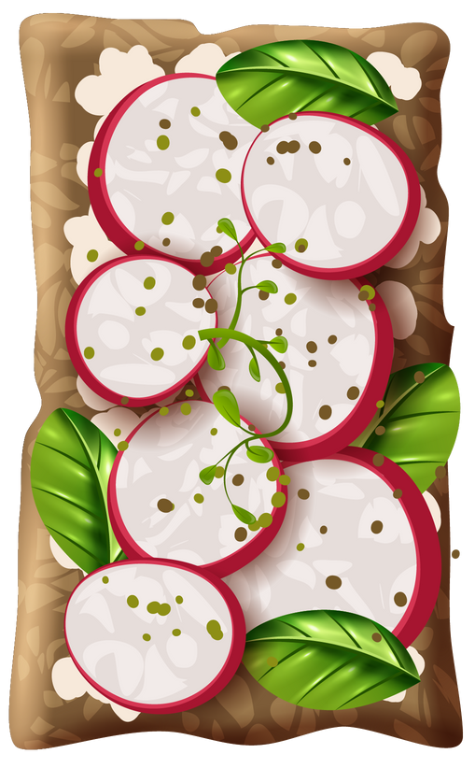

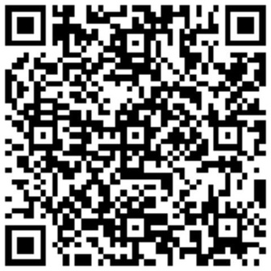
THANK YOU FOR YOUR TIME AND ATTENTION
You can connect with me on LinkedIn

